Slide 1


CE252 : Digital Electronics
AY : 2020-21
Chapter 2
Boolean Algebra
Presented By :
Prof. Bhavika Patel
DEPSTAR, FTE

Slide 2
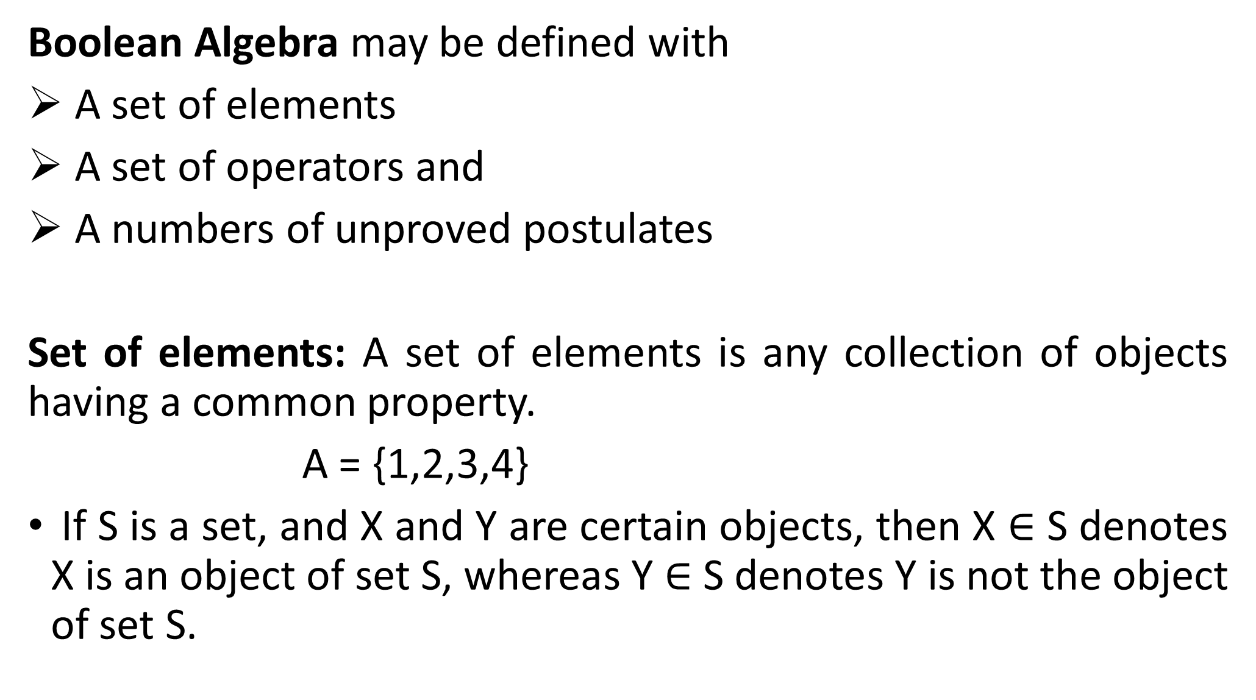

Slide 3
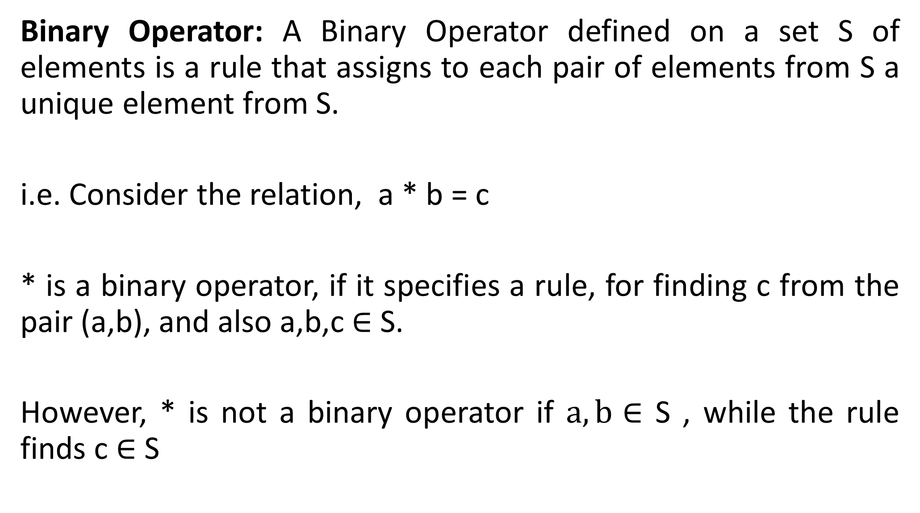
Binary Operator: A Binary Operator defined on a set S of elements is a rule that assigns to each pair of elements from S a unique element from S.
i.e. Consider the relation, a * b = c
* is a binary operator, if it specifies a rule, for finding c from the pair (a,b), and also a,b,c$∈$S.
However, * is not a binary operator if $a,b∈$S , while the rule finds c $∈$ S

Slide 4
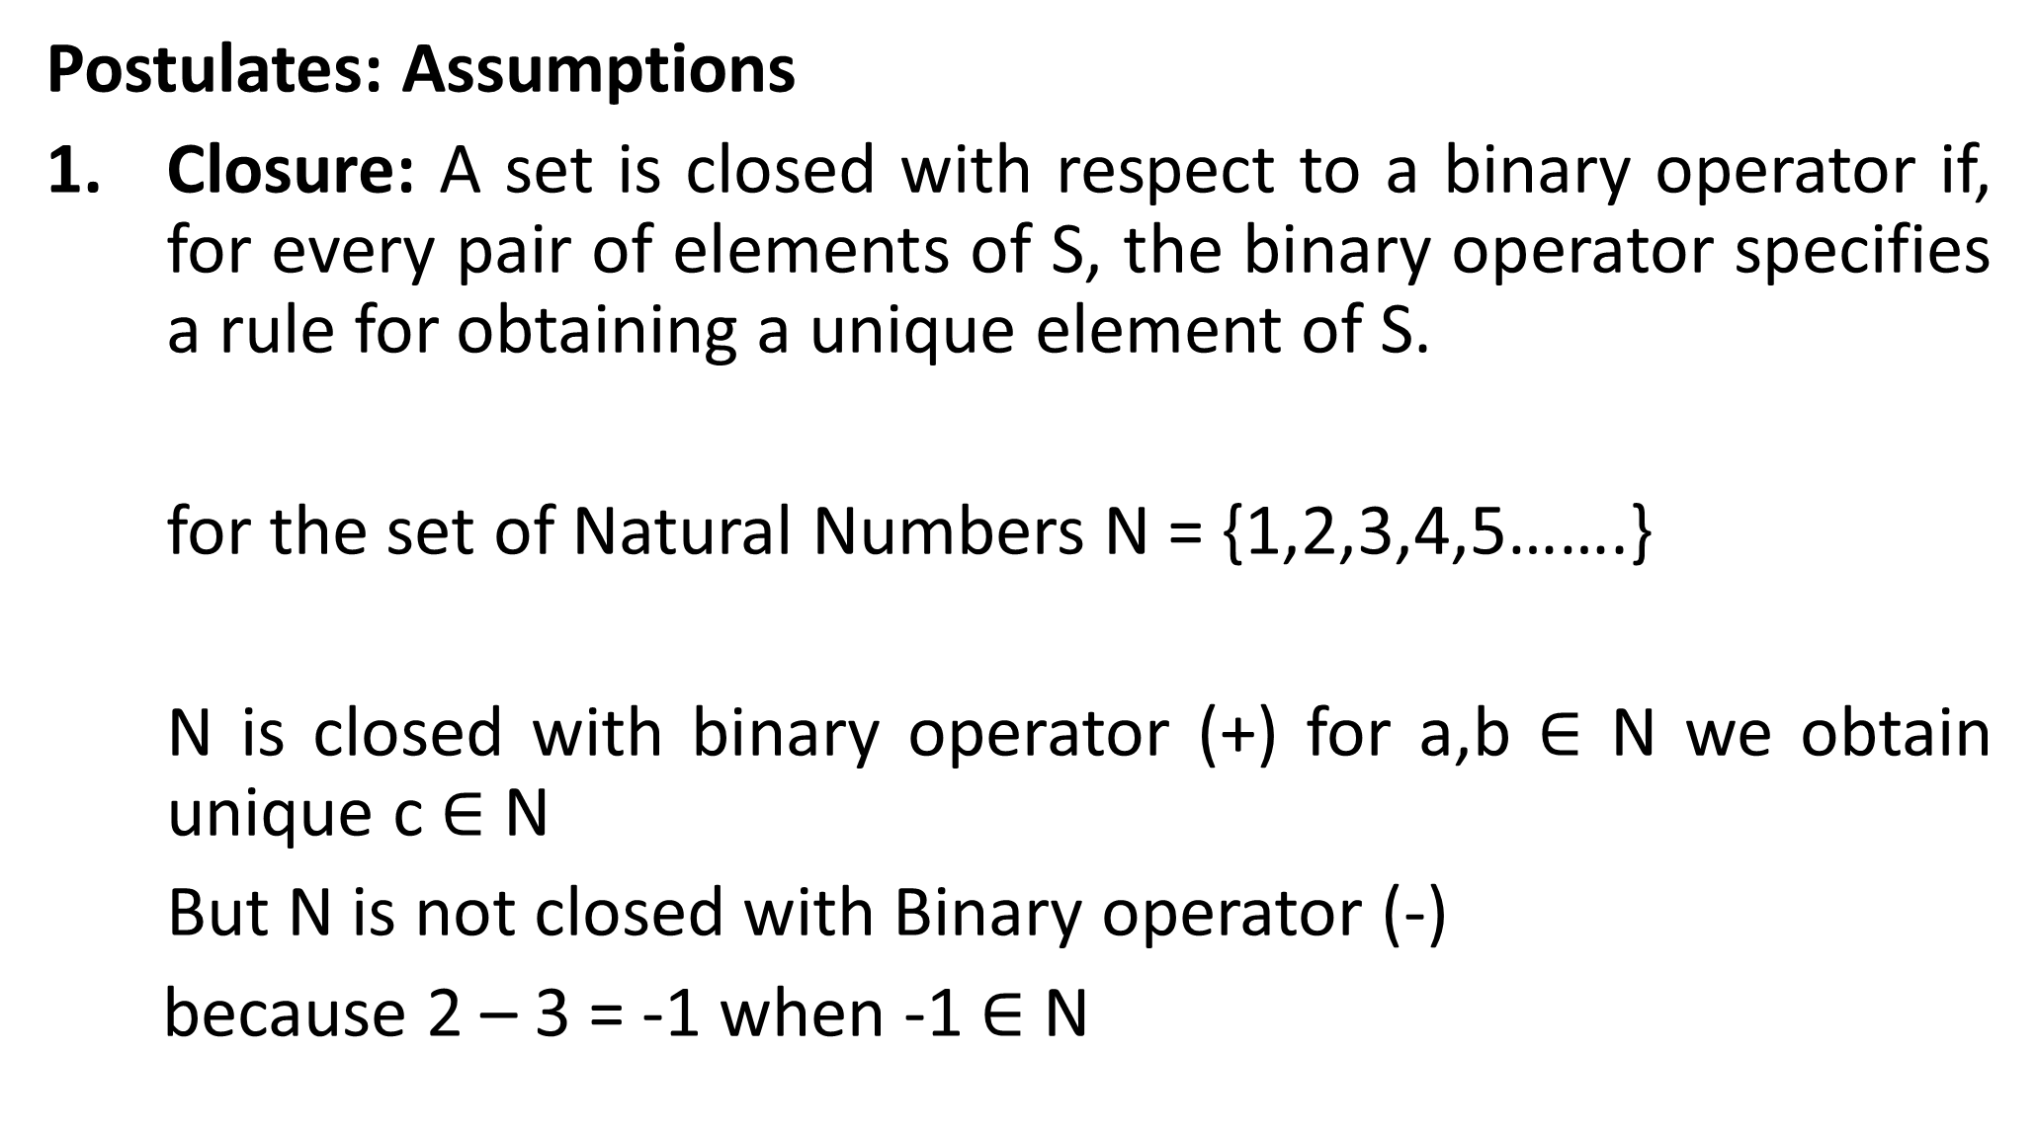
Postulates: Assumptions
Closure: A set is closed with respect to a binary operator if, for every pair of elements of S, the binary operator specifies a rule for obtaining a unique element of S.
for the set of Natural Numbers N = {1,2,3,4,5…….}
N is closed with binary operator (+) for a,b $∈$ N we obtain unique c $∈$ N
But N is not closed with Binary operator (-)
because 2 – 3 = -1 when -1 $∈$ N

Slide 5
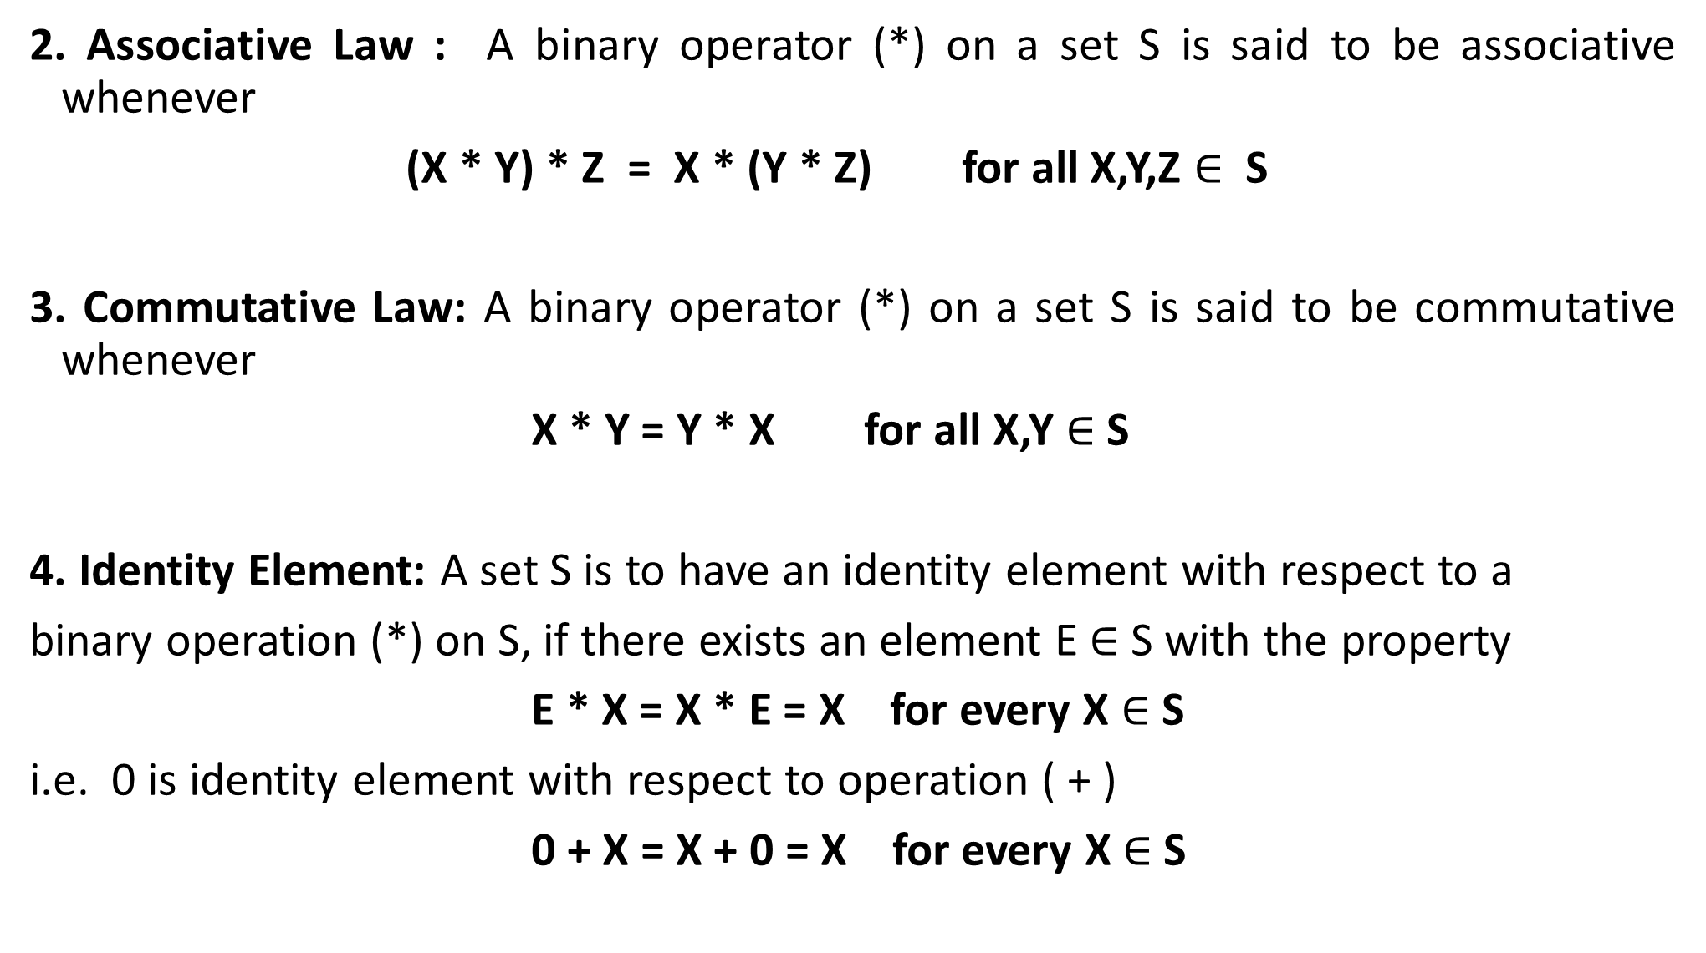
2. Associative Law : A binary operator (*) on a set S is said to be associative whenever
(X * Y) * Z = X * (Y * Z) for all X,Y,Z $∈$ S
3. Commutative Law: A binary operator (*) on a set S is said to be commutative whenever
X * Y = Y * X for all X,Y $∈$ S
4. Identity Element: A set S is to have an identity element with respect to a
binary operation (*) on S, if there exists an element E $∈$ S with the property
E * X = X * E = X for every X $∈$S
i.e. 0 is identity element with respect to operation ( + )
0 + X = X + 0 = X for every X $∈$S

Slide 6
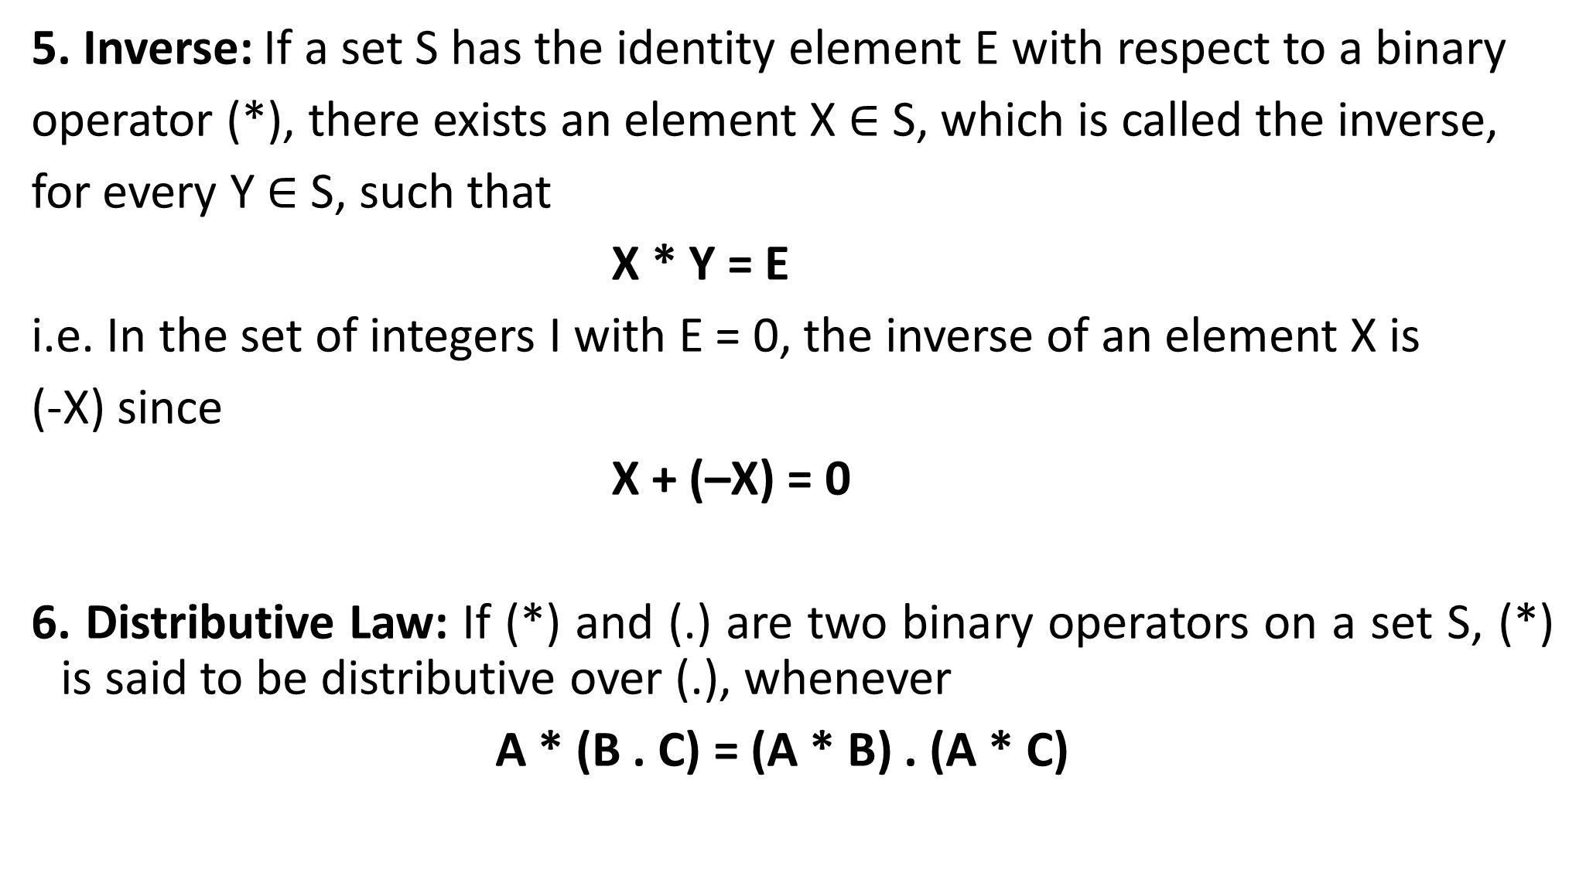
5. Inverse: If a set S has the identity element E with respect to a binary
operator (*), there exists an element X $∈$ S, which is called the inverse,
for every Y $∈$ S, such that
X * Y = E
i.e. In the set of integers I with E = 0, the inverse of an element X is
(-X) since
X + (–X) = 0
6. Distributive Law: If (*) and (.) are two binary operators on a set S, (*) is said to be distributive over (.), whenever
A * (B . C) = (A * B) . (A * C)

Slide 7
SUMMARY
The binary operator (+) defines addition.
The additive identity is 0.
The additive inverse defines subtraction.
The binary operator (.) defines multiplication.
The multiplication identity is 1.
The multiplication inverse of A is 1/A, defines division i.e., A . 1/A = 1
The only distribution law applicable is that of (.) over (+)
A . (B + C) = (A . B) + (A . C)

Slide 8
DEFINITION OF BOOLEAN ALGEBRA
In 1854 George Boole introduced a systematic approach of logic and
developed an algebraic system to treat the logic functions, which is now
called Boolean algebra.
In 1938 C.E. Shannon developed a two-valued Boolean algebra called
Switching algebra, and demonstrated that the properties of two-valued
or bistable electrical switching circuits can be represented by this
algebra.
The postulates formulated by E.V. Huntington in 1904 are employed for
the formal definition of Boolean algebra. However, Huntington
postulates are not unique for defining Boolean algebra and other
postulates are also used.

Slide 9
The following Huntington postulates are satisfied for the definition of
Boolean algebra on a set of elements S together with two binary operators
(+) and (.)
1. (a) Closure with respect to the operator (+).
(b) Closure with respect to the operator (.).
2. (a) An identity element with respect to + is designated by 0 i.e.,
X + 0 = 0 + X = X
(b) An identity element with respect to . is designated by 1 i.e.,
X . 1 = 1 . X = X
3. (a) Commutative with respect to (+), i.e., X + Y = Y + X
(b) Commutative with respect to (.), i.e., X . Y = Y . X

Slide 10
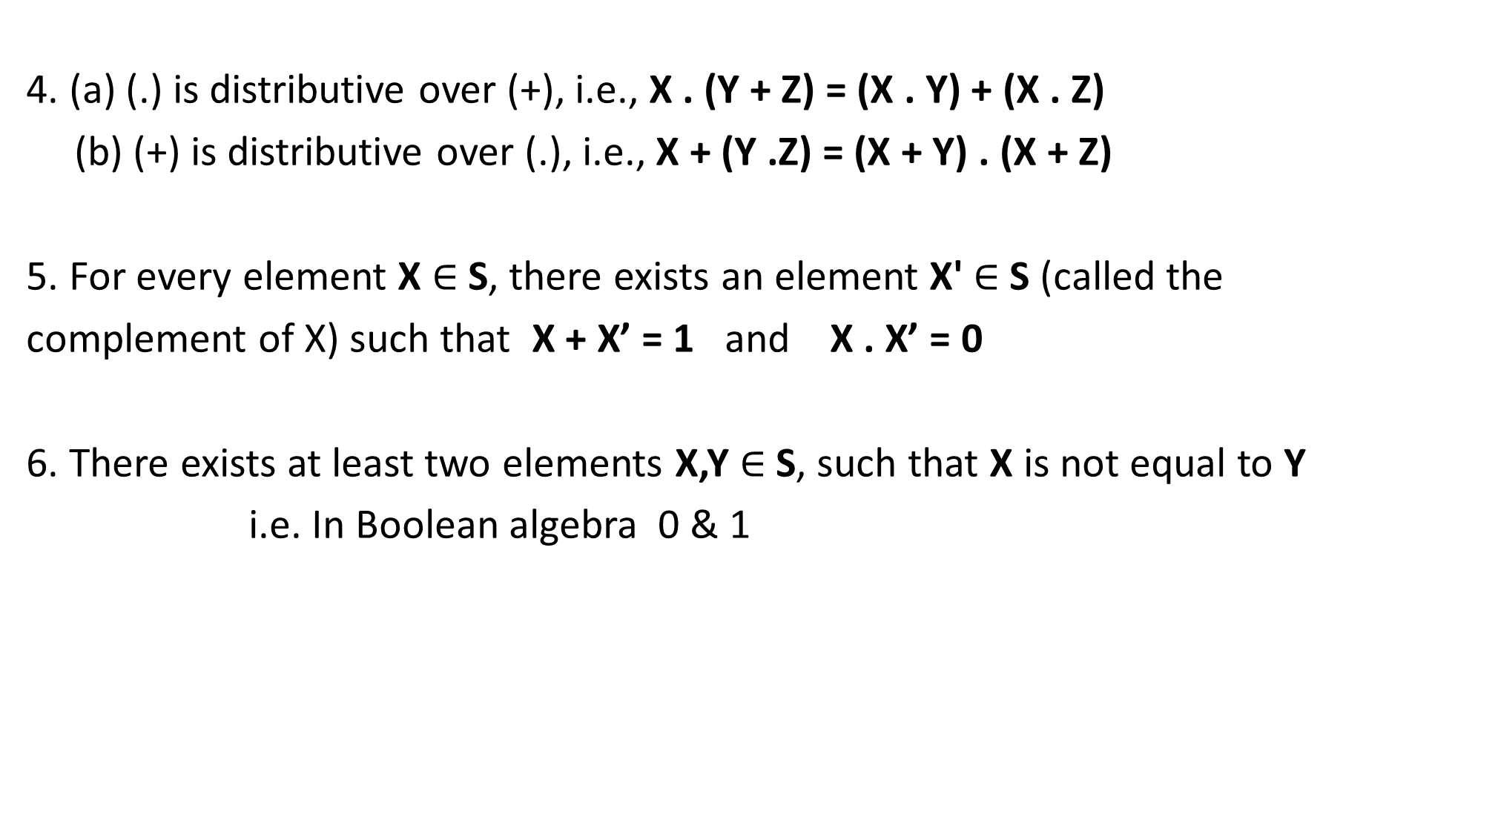
4. (a) (.) is distributive over (+), i.e., X . (Y + Z) = (X . Y) + (X . Z)
(b) (+) is distributive over (.), i.e., X + (Y .Z) = (X + Y) . (X + Z)
5. For every element X $∈$ S, there exists an element X' $∈$ S (called the
complement of X) such that X + X’ = 1 and X . X’ = 0
6. There exists at least two elements X,Y $∈$ S, such that X is not equal to Y
i.e. In Boolean algebra 0 & 1

Slide 11
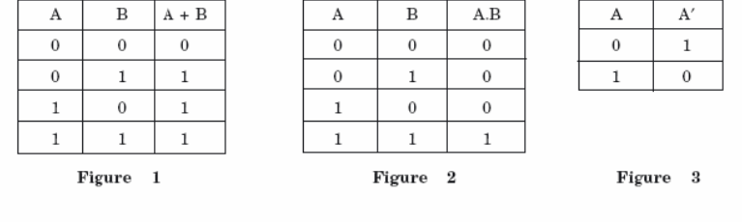
TWO-VALUED BOOLEAN ALGEBRA
Two-valued Boolean algebra is defined on a set of only two elements, S={0,1}, with rules for two binary operators (+) and (.) and inversion or complement as shown In the following operator tables at Figures 1, 2, and 3 respectively.

Slide 12
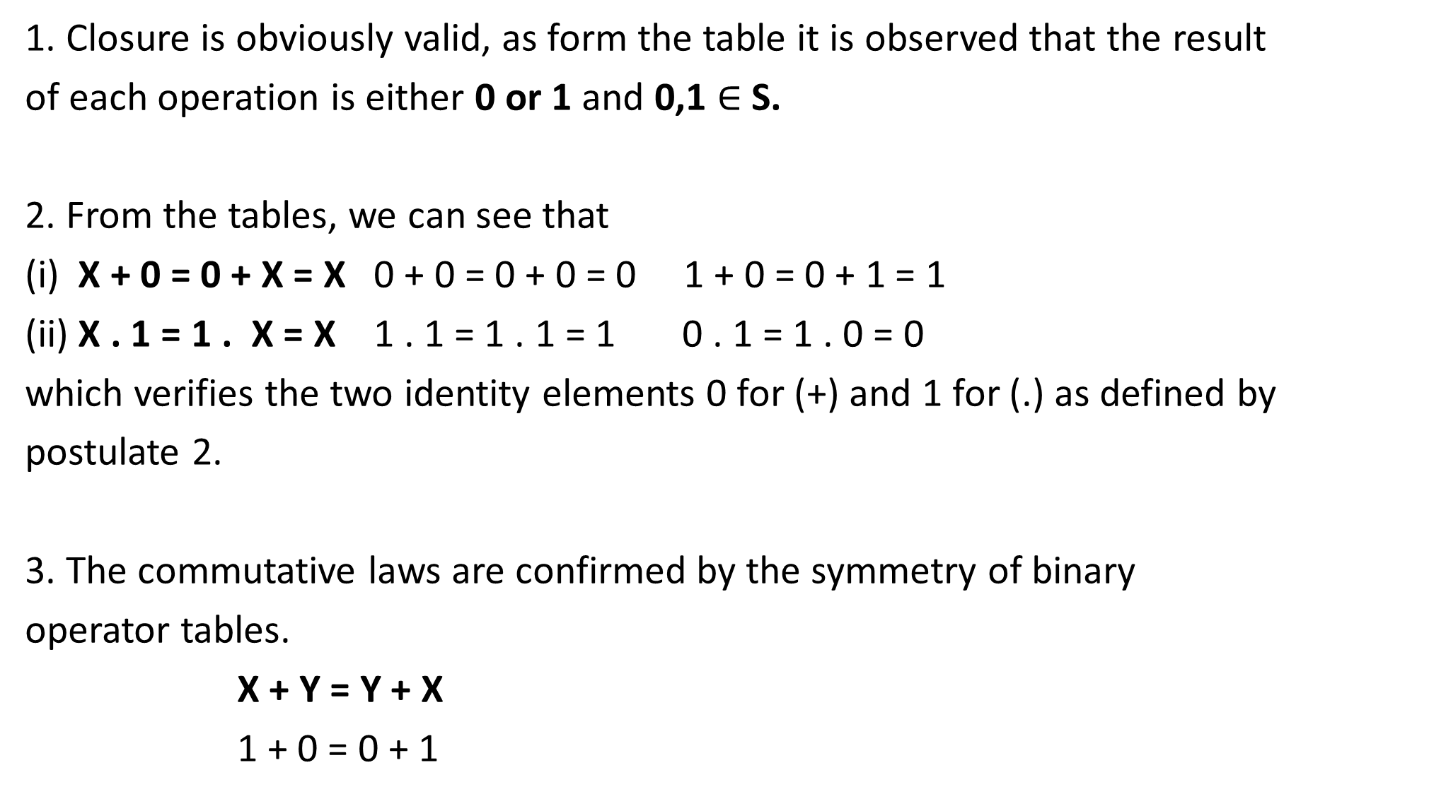
1. Closure is obviously valid, as form the table it is observed that the result
of each operation is either 0 or 1 and 0,1 $∈$ S.
2. From the tables, we can see that
(i) X + 0 = 0 + X = X 0 + 0 = 0 + 0 = 0 1 + 0 = 0 + 1 = 1
(ii) X . 1 = 1 . X = X 1 . 1 = 1 . 1 = 1 0 . 1 = 1 . 0 = 0
which verifies the two identity elements 0 for (+) and 1 for (.) as defined by
postulate 2.
3. The commutative laws are confirmed by the symmetry of binary
operator tables.
X + Y = Y + X
1 + 0 = 0 + 1

Slide 13
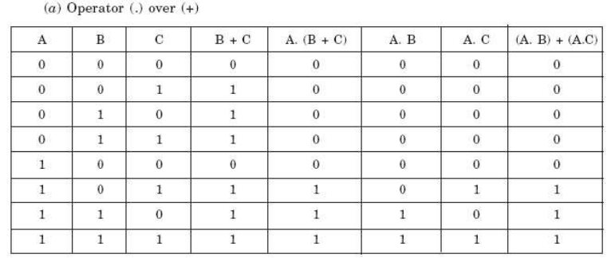
4. The distributive laws of (.) over (+) i.e., A . (B+C) = (A . B) + (A . C), and
(+) over (.) i.e., A + ( B . C) = (A+B) . (A+C) can be shown to be applicable
with the help of the truth tables considering all the possible values of A, B,
and C as under. From the complement table it can be observed that

Slide 14
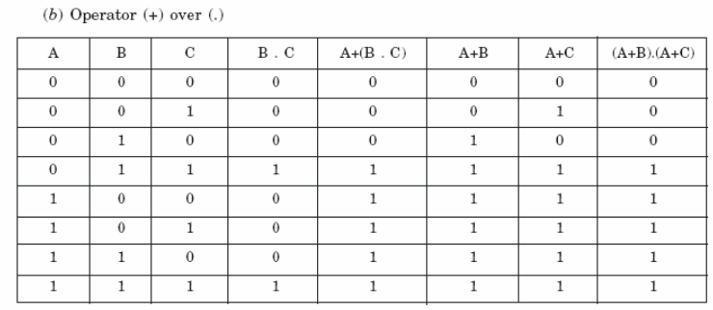
(C) A + A’ = 1, since, 0 + 0’= 0 + 1 = 1 1 + 1’ = 1 + 0 = 1
(D) A . A’ = 0, since, 0 . 0’ = 0 . 1 = 0 1 . 1’ = 1 . 0 = 0
5. Postulate 6 also satisfies two-valued Boolean algebra that has two distinct elements 0 and 1 where 0 is not equal to 1

Slide 15
BASIC PROPERTIES AND THEOREMS OF BOOLEAN ALGEBRA
Principle of Duality
From Huntington postulates, it is evident that they are grouped in pairs as part (a) and (b) and every algebraic expression deductible from the postulates of Boolean algebra remains valid if the operators and identity elements are interchanged.
This means one expression can be obtained from the other in each pair by interchanging every element i.e., every 0 with 1, every 1 with 0, as well as interchanging the operators i.e., every (+) with (.) and every (.) with (+). This important property of Boolean algebra is called principle of duality.
i.e. 0 <->1 & + <-> .
0 . 1 = 0 <-> (b) 1 + 0 = 1
i.e. (b) is dual of (a)

Slide 16
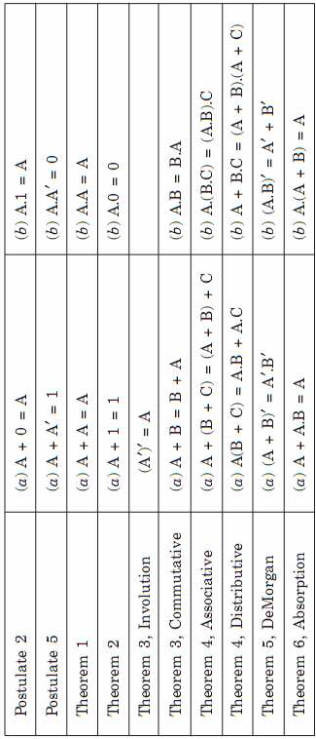
The following is the complete list of postulates and theorems useful for two-valued Boolean algebra

Slide 17
Other Important Theorems
Theorem 1(a): A + A = A
A + A = (A + A).1 by postulate 2(b)
= (A + A) . ( A + A’) by postulate 5(a)
= A + (A.A’) by postulate 4(b)
= A + 0 by postulate 5(b)
= A by postulate 2(a)
Theorem 1(b): A . A = A
A . A = (A . A) + 0 by postulate 2(a)
= (A . A) + ( A . A’) by postulate 5(b)
= A (A + A’) by postulate 4(a)
= A . 1 by postulate 5(b)
= A by postulate 2(b)

Slide 18
Theorem 2(a): A + 1 = 1
Theorem 2(b): A . 0 = 0 by Duality
Theorem 6(a): A + A.B = A
A + A.B = A . 1 + A.B by postulate 2(b)
= A ( 1 + B) by postulate 4(a)
= A . 1 by theorem 2(a)
= A by postulate 2(b)
Theorem 6(b): A ( A + B ) = A by Duality
Venn Diagram

Slide 19
Truth tables :
Both sides of the relation are checked to yield identical results for all possible combinations of variables involved.
The following truth table verifies the 6(a) absorption theorem.
Following Truth Table verifies the De Morgan’s theorem (x+y)’=x’.y’
X | Y | XY | X+XY
0 | 0 | 0 | 0
0 | 1 | 0 | 0
1 | 0 | 0 | 1
1 | 1 | 1 | 1
X | Y | X+Y | (X+Y)’ | X’ | Y’ | X’Y’
0 | 0 | 0 | 1 | 1 | 1 | 1
0 | 1 | 1 | 0 | 1 | 0 | 0
1 | 0 | 1 | 0 | 0 | 1 | 0
1 | 1 | 1 | 0 | 0 | 0 | 0

Slide 20
BOOLEAN FUNCTIONS
Binary variables have two values, either 0 or 1. A Boolean function is an expression formed with binary variables, the two binary operators AND and OR, one unary operator NOT, parentheses and equal sign.
The value of a function may be 0 or 1, depending on the values of variables present in the Boolean function or expression. For example, if a Boolean function is expressed algebraically as
F = AB’C
then the value of F will be 1, when A = 1, B = 0, and C = 1. For other
values of A, B, C the value of F is 0

Slide 21
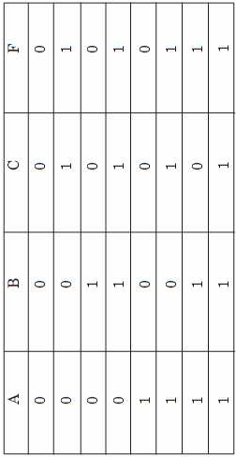
Boolean functions can also be represented by Truth Tables. A truth table is the tabular form of the values of a Boolean function according to the all possible values of its variables. For an n number n combinations of 1s and 0s are listed and one column represents function values according to the different combinations of variables, 2
For example, for three variables the Boolean function F = AB + C truth table can be
written as below in Figure

Slide 22
SIMPLIFICATION OF BOOLEAN EXPRESSIONS
Simplify the Boolean function F = X + (X’ . Y)
= (X + X’) . (X + Y)
= 1 . (X + Y)
= X + Y
Simplify the Boolean function F = X . (X’+Y)
= (X . X’) + (X . Y)
= 0 + (X . Y)
= (X . Y)
Simplify the Boolean function F = (X’ . Y’ . Z) + (X’ . Y . Z) + (X . Y’)
= (X’ . Z)(Y’ + Y) + (X . Y’)
= (X’ .Z) . 1 + (X . Y’)
Implementation of Boolean functions with gate (Circuit)

Slide 23
Canonical And Standard Forms
Boolean function expressed as a sum of minterms or product of maxterms are said to be canonical form.
Standard form: Sum Of Product (SOP) : AB’ + AC’ + ABC
Product Of Sum (POS) : (A + B’) ▪ (A +C’) ▪ (A + B + C)
SUM -> OR gate
PRODUCT -> AND gate

Slide 24
Minterm
A product term containing all N variables of the function in either true or complemented form is called the minterm. Each minterm is obtained by an AND operation of the variables in their true form or complemented form.
For a two-variable function, four different combinations are possible, such as, A’B’, A’B, AB’, and AB. These product terms are called the fundamental products or standard products or minterms.
Note that, in the minterm, a variable will possess the value 1, if it is in true or uncomplemented form, whereas, it contains the value 0, if it is in complemented form .
Symbol for Minterm is m_{j}, where j denotes the decimal equivalent of binary number

Slide 25
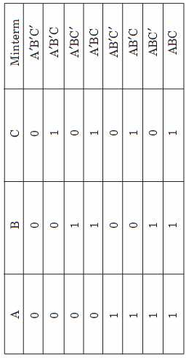
For three variables function, eight minterms are possible as listed in the following table in Figure

Slide 26
Sum of Minterms
F = A + B’C
A = A (B + B’)
= AB + AB’
= AB(C +C’) + AB’(C + C’)
= ABC + ABC’ + AB’C + AB’C’
B’C = B’C (A +A’) = AB’C + A’B’C
F = ABC + ABC’ + AB’C + AB’C’ + AB’C + A’B’C
= ABC + ABC’ + AB’C + AB’C’ + A’B’C
= A’B’C + AB’C’ + AB’C + ABC’ + ABC
= m1 + m4 + m5 + m6 + m7
F (A,B,C) = Σ (1, 4, 5, 6, 7)

Slide 27
Steps to obtain Sum of Product (MINTERMS)
Find out how many variables is there in equation
List out all minterms for given variables. i.e m0 to m7 for 3 variables
Check the given equation is in SOP FORM or not? If not then convert it into SOP form. i.e ab + bc + ac’ form
Find out missing variable in each term & add that variable in that term. i.e for A,B,C: B is missing in AC’. Add B in AC’ using AC’ = AC’(B+B’) = ABC’ + AB’C’
ADD ALL MISSING VARIABLES IN EACH TERMS OF THE EQUATION
ARRANGE ALL OBTAINED MINTERMS IN ASCENDING ORDERS. i.e from m0 to m7 for 3 variables

Slide 28
MAXTERM
A sum term containing all n variables of the function in either true or complemented form is called the maxterm. Each maxterm is obtained by an OR operation of the variables in their true form or complemented form.
Four different combinations are possible for a two-variable function, such as, A’ + B’, A’ + B, A + B', and A + B. These sum terms are called the standard sums or maxterms.
Note that, in the maxterm, a variable will possess the value 0, if it is in true or uncomplemented form, whereas, it contains the value 1, if it is in complemented form.
Symbol for Maxterm is Mj, where j denotes the decimal equivalent of binary number

Slide 29
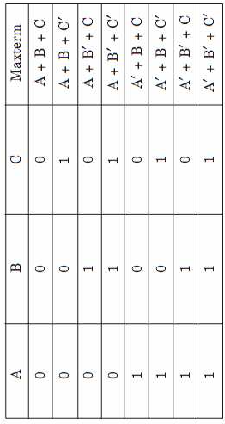
Like minterms, for a three-variable function, eight maxterms are also possible as listed in the following table

Slide 30
Product of Maxterms
F = xy + x’z
= (xy + x’)(xy + z)
= (x + x’) (y + x’) (x + z) (y + z)
= (x’ + y) (x + z) (y + z)
x’ + y = x’ + y + zz’ = (x’ + y + z) (x’ + y + z’)
x + z = x + z + yy’ = (x + z + y) (x+ z + y’)
y + z = y + z + xx’ = (y + z + x) (y + z + x’)
F = (x + y + z) (x + y’ + z) (x’ + y + z) (x’ + y + z’)
= M0M2M4M5
F (x, y, z) = П (0, 2, 4, 5)

Slide 31
Steps to obtain PRODUCT OF SUM (MAXTERMS)
Find out how many variables is there in given equation
List out all maxterms for given variables. i.e M0 to M7 for 3 variables
Check the given equation is in POS FORM or not? If not then convert it into POS form. i.e (a + b)(b + c)(a +c’) form
Find out missing variable in each term & add that variable in that term. i.e for A,B,C: B is missing in (A + C’). Add B in (A + C’) using (A + C’) = (A + C’)+BB’
= (A + B + C)(A + B’ + C)
ADD ALL MISSING VARIABLES IN EACH TERMS OF THE EQUATION
ARRANGE ALL OBTAINED MAXTERMS IN ASCENDING ORDERS. i.e from M0 to M7 for 3 variables

Slide 32
x y z function f1 function f2
0 0 0 0 0
0 0 1 1 0
0 1 0 0 0
0 1 1 0 1
1 0 0 1 0
1 0 1 0 1
1 1 0 0 1
1 1 1 1 1
F1 = x’y‘z + xy’z’ + xyz = m1 + m4 + m7
F2 = x’yz + xy’z + xyz’ + xyz = m3 + m5 + m6 + m7

Slide 33
Conversion Between Canonical Forms
F(A, B, C) = Σ (1, 4, 5, 6, 7) (Sum Of Product) (Sum Of Minterms)
F’(A, B, C) = Σ (0, 2, 3) = m0 + m2 + m3
complement of F’ = F = (m0 + m2 + m3)’
= m0’ . m2’ . m3’
= M0.M2.M3
= П (0, 2, 3) (Product Of Sum) (Product Of Maxterms)
mj’ = Mj
F (A, B, C) = Σ (1, 4, 5, 6, 7) = П (0, 2, 3)

Slide 34
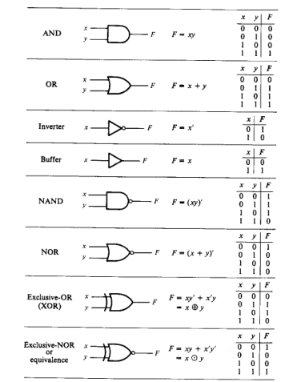
LOGIC GATES

Slide 35
IC DIGITAL LOGIC FAMILIES
TTL Transistor – Transistor Logic
ECL Emitter – Coupled Logic
MOS Metal – Oxide Semiconductor
CMOS Complementary Metal – Oxide Semiconductor
IIL Integrated – Injection Logic
TTL has an extensive list of digital functions and is currently the most popular logic family.
ECL is used in system requiring high speed operations.
MOS & IIL are used in circuits requiring high component density (Large Number of Components like Transistors)
CMOS is used in system requiring low power consumption.

Slide 36
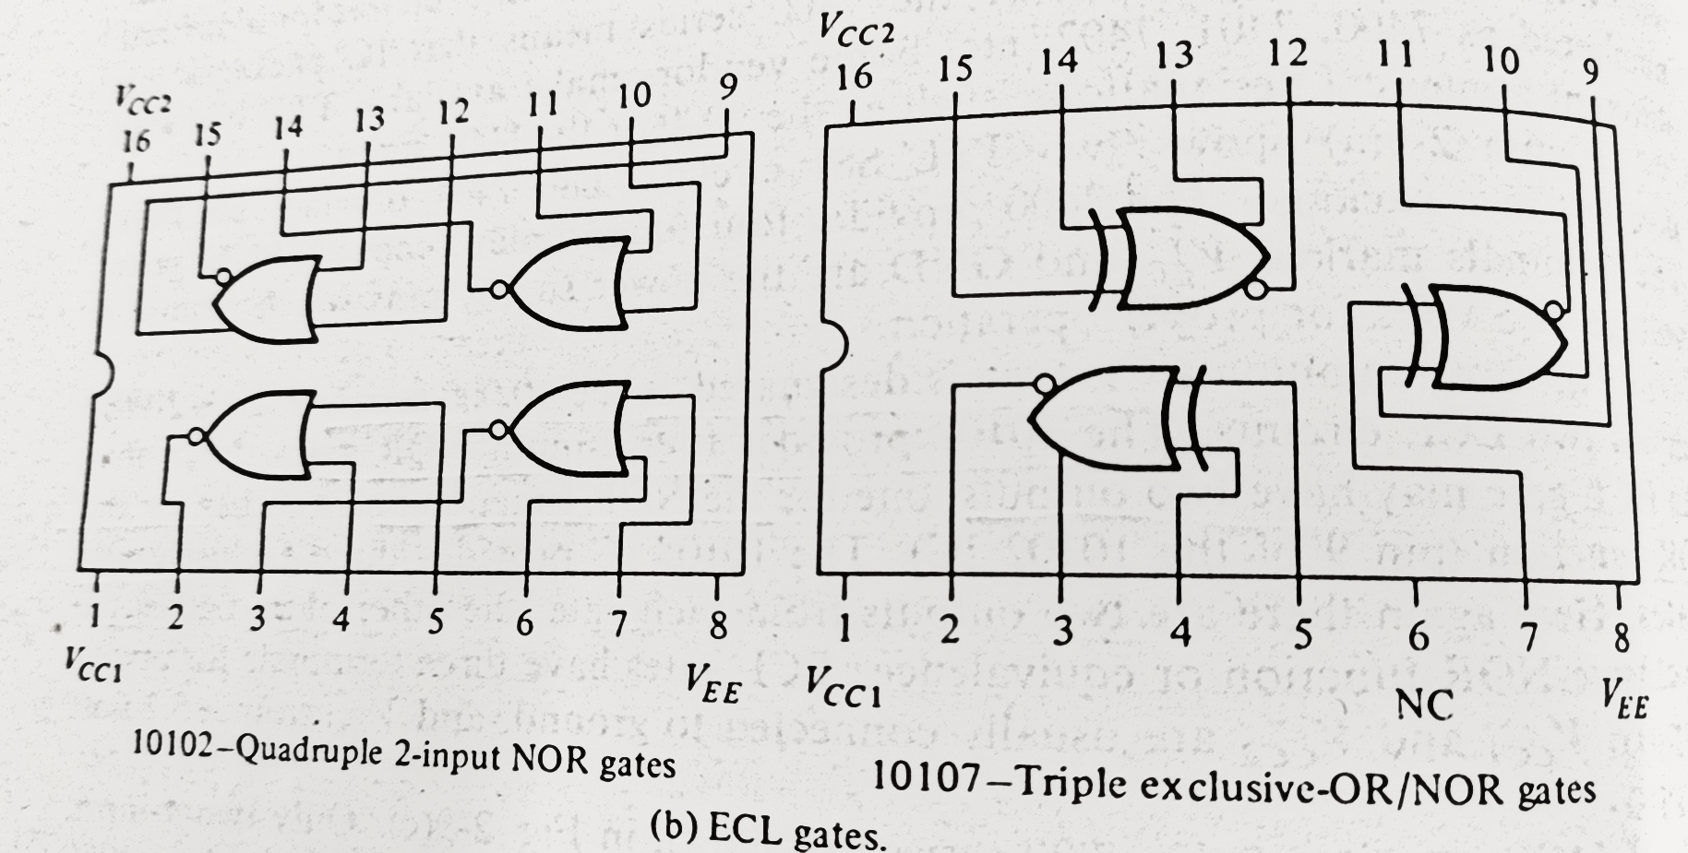
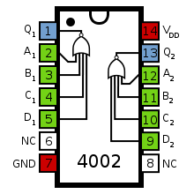
TTL - 5400 & 7400 SERIES i.e. 7400 7402 7432
ECL – 10000 SERIES i.e. 10102(Quad 2-Input NOR Gate) & 10107(triple–2 input exclusive OR/NOR gate)
CMOS – 4000 SERIES i.e. 4002(dual 4-input NOR gate)

Slide 37
Positive and Negative Logic
Logic Value Signal Value Logic Value Signal Value
1 H 0 H
0 L 1 L
POSITIVE LOGIC NEGATIVE LOGIC

Slide 38
Special Characteristics:
Fan out: specifies the number of standard loads(means amount of current needed by an input of another gate in same IC) that the output of a gate can drive without impairing its normal operation.
Power dissipation: is the supplied power required to operate the gate. This parameter is expressed in milliwatts (mW). It represents the power delivered to the gate from power supply.
Propagation delay: is the average transition delay time for a signal to propagate from input to output when the binary signals change in value. This parameter is expressed in nanoseconds (ns)
Noise Margin: is the maximum noise voltage added to the input signal of a digital circuit that does not cause an undesirable change in the circuit output.

Slide 39
Characteristics of IC Logic Families:
IC logic family | Fan-out | Power dissipation (mW) | Propagation delay (ns) | Noise margin (V)
Standard TTL | 10 | 10 | 10 | 0.4
Schottky TTL | 10 | 22 | 03 | 0.4
Low-power Schottky TTL | 20 | 02 | 10 | 0.4
ECL | 25 | 25 | 02 | 0.2
CMOS | 50 | 0.1 | 25 | 3

Slide 40
SUMMARY OF CHAPTER 2
Basic Definitions
Axiomatic definitions of Boolean Algebra
Basic Theorems & Properties of Boolean Algebra
Boolean Functions
Canonical & Standard Forms
Minterms & Maxterms
Digital Logic Gates
IC Digital Logic Families
Special Characteristics of ICs

